Slide 1
Meet the Teacher- Year 5
Miss Parton and Mrs Hill

Slide 2
A Typical Day in Year 5…
School starts at 8:45am. A typical day in Year 5 is fast paced and action packed!
Children arrive at school, put their belongings away in their lockers and settle down quietly to complete their early morning activities during registration time. They then move straight into morning lessons, which are the core subjects: English and Maths.
Lunch
The afternoon runs similarly to the morning, with Topic based learning. The children will have an afternoon starter, these are either spellings, times tables or fluent in five. They then move into the foundation subjects.
Throughout the week, the children have daily handwriting practice, whole class/ guided reading, reading VIPERS and independent reading opportunities.

Slide 3
How we assess the children…
Assessment in KS2 is carried out daily, using live marking and targeted questioning as the children are working. This is to ensure that feedback is immediate and children can respond immediately, ensuring the misconceptions are quickly addressed.
Children will then have differentiated work to suit their ability or need.
Throughout the year, children will take part in assessments in reading, writing and mathematics to inform us of next steps; gaps in learning etc.
The Statutory Assessment does not make up the whole picture. We use teacher assessment to make a final judgement on whether children have met the Expected Standard for the end of Year 5.

Slide 4
Curriculum…
English– is based on a whole class text that is normally linked to that term’s topic. Whole class reading also takes place daily to help children to become immersed in a text. This means by the end of the half term they will have read and understood a novel in great detail.
Maths Mastery– is about deepening children’s understanding, use and manipulation of all things mathematical.
Fluent in five – takes place daily to help develop speed and accuracy with arithmetic skills.
We will also teach Geography, History, Science, French, ICT, RE, PSHE,
Music and Art/ Design. Learning in these subjects is, where possible, linked to each term’s topics.

Slide 5
Key Topics…
Stargazers
Time Traveller
Alchemy Island
Tudors
Pharaohs

Slide 6
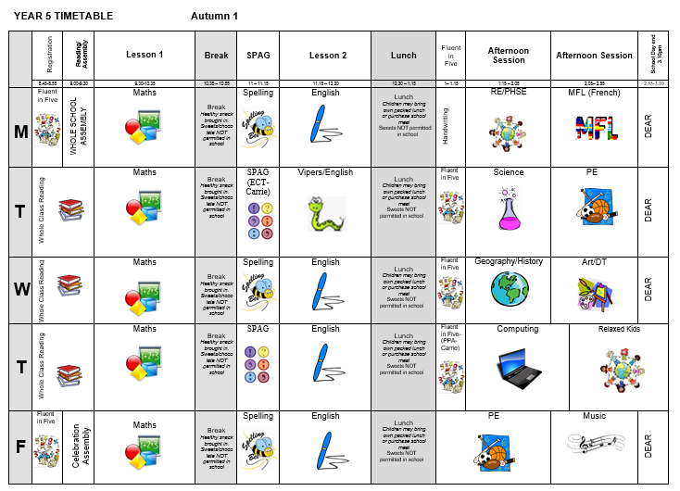
Year 5 Timetable…

Slide 7
Home Learning…
Homework will be expected in on eSchools weekly.
English and Maths homework will alternate each week- after the half term both will be expected weekly.
Children will also be given a spelling list to practice at home with a new pattern each week. Year 5-6 Spellings are on eschools home page as well as additional resources.
Children will have opportunities to read in school time throughout the week, but we strongly encourage home reading too. We ask that you use the reading record to record this.

Slide 8
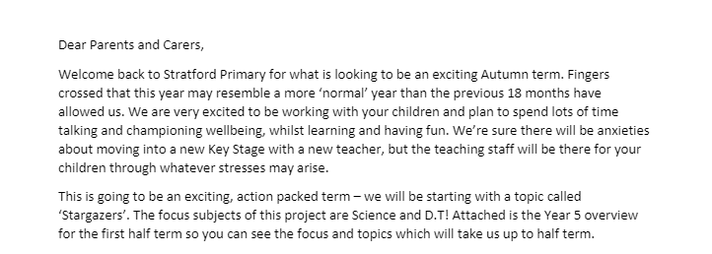
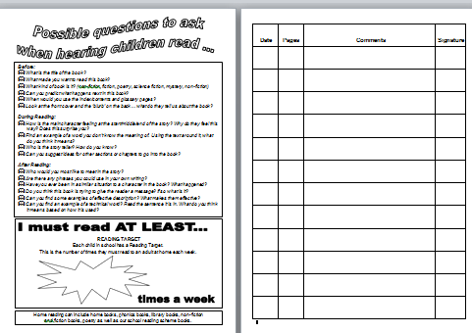
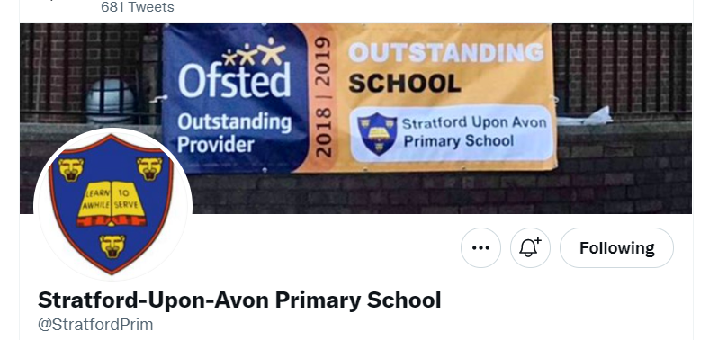
Communication…
Timetable​
Parent letter
Weekly News Letter​
eSchools-home learning
Reading diary ​
Twitter- learning

Slide 9
Communication…
We are always here to support and listen. You may come and talk to us at the end of the school day. If it is urgent please email the school office. ​
​
If you have any minor inquiries, such as lost items/afterschool clubs, you can contact us via eSchools or use the Me to You sheets. You can also use reading diaries to send messages. ​
​
Important issues can be spoken about in person and appointments with teachers can either be done directly through teachers or via the school office. ​
​Serious injuries will be either a phone call home or a face to face chat. Minor injuries such as cuts and grazes will be communicated via Accident forms which are given out at the end of the day.​​
Please check eSchools for copies of home learning sheets and homework tasks.

Slide 10
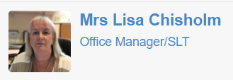
Additional Support/Concerns…
If you have any concerns about your
child or need our support you can contact me directly through eSchools or come and talk to me after school. You may want to contact the school office and arrange a meeting in private.
The DSL team are always welcoming and can support you with your concerns.
You can email or phone- more contact information is available on the website.​
​

Slide 11
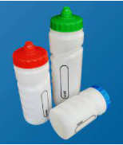
Expectations…
Behaviour – high expectations, in class, in the playground, moving around school, on educational visits, when visitors are in and during after school clubs.
School uniform / PE kit / Lost Property – LABEL!
Presentation, in school and when completing homework.
Encourage independence – children to inform when they need a book changed, need to hand in a letter, bring sheets and uniform home, hand homework in.
Named water bottle needs to be in school every day.

Slide 12
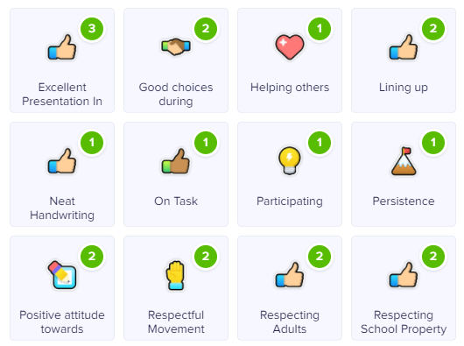
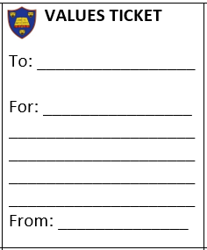
Celebrating Success…
Well-being Warrior in celebration assembly
Topic Sharing Events
Looking at the website and Twitter
Stickers, Dojo points, House Points and Values Tickets

Slide 13
AOB…
​
Remind children at home they have a locker in which to store their items, encourage that independence​
Healthy snacks
School Bank
​
Come to school in PE Kit on Tuesday and Friday.​
​
Following us on Twitter ​
​
RESPECT – the one school rule ​
​

