Slide 1
Welcome to Year 1
Miss White
Mrs Beesley, Mrs Buchanan, Miss Rushton and Mrs Bean

Slide 2
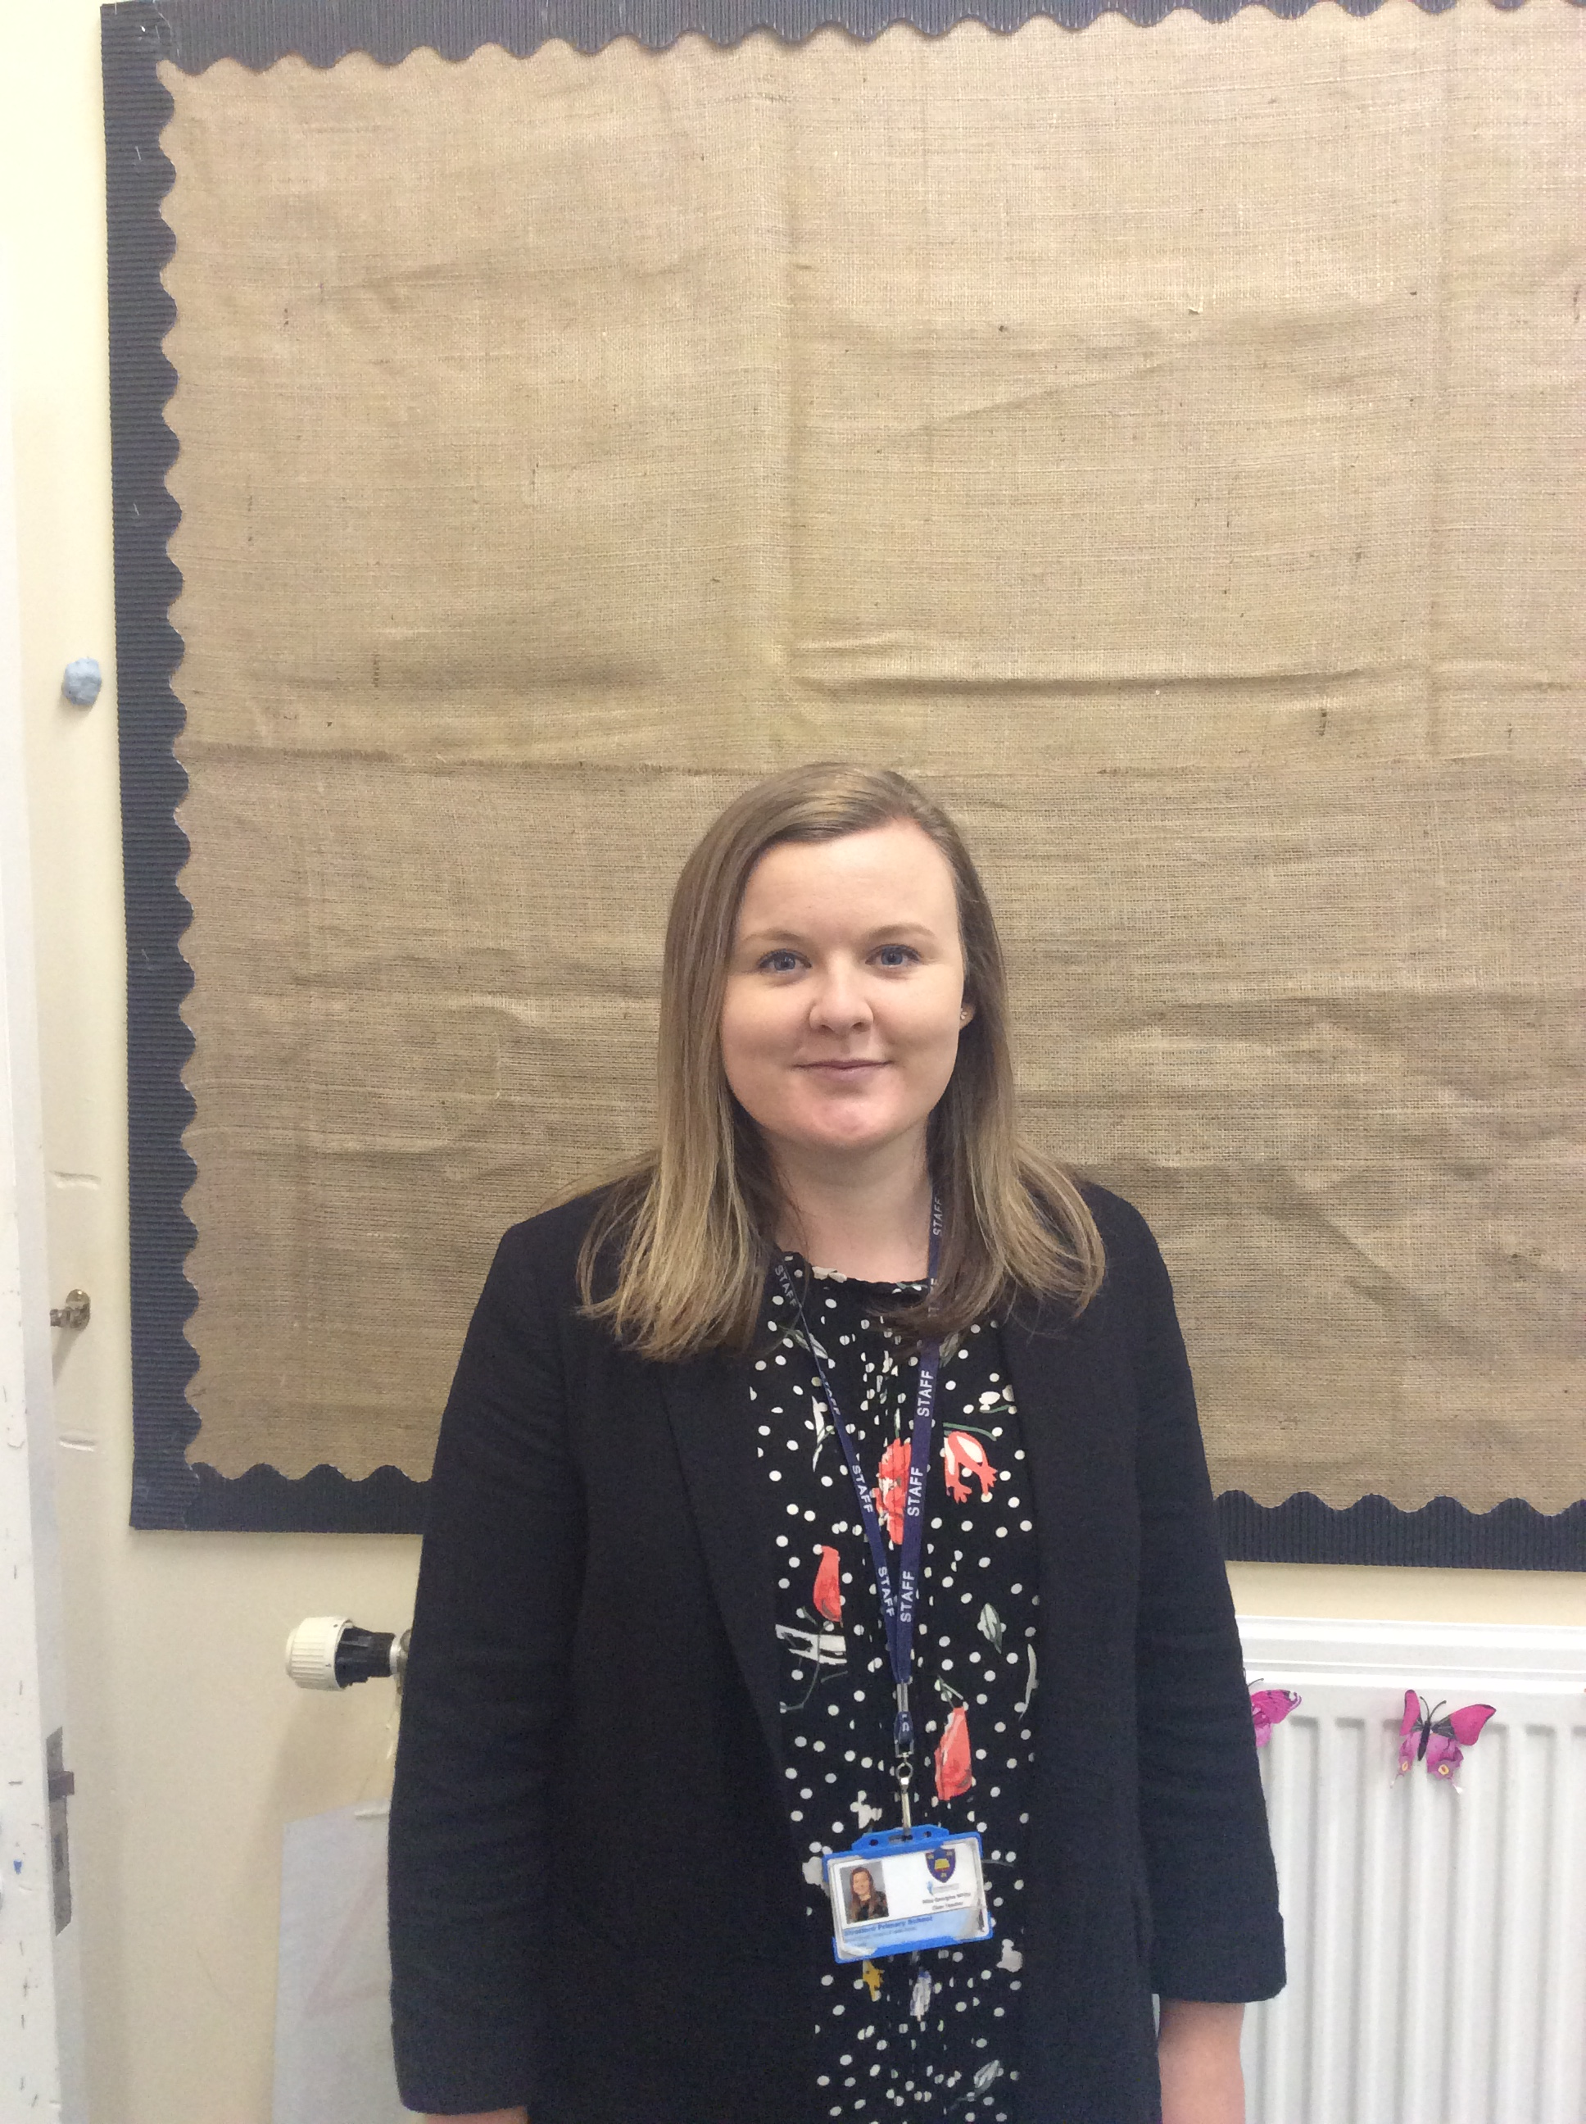
Meet your teacher – Miss White
Welcome to Year 1!
My name is Miss White and I will be your teacher. I am really looking forward to teaching you and getting up to some fun and exciting activities.
Facts about Miss White:
I love going on adventures and visiting new places
I love baking and trying new recipes
I love reading
I enjoy going on bike rides

Slide 3
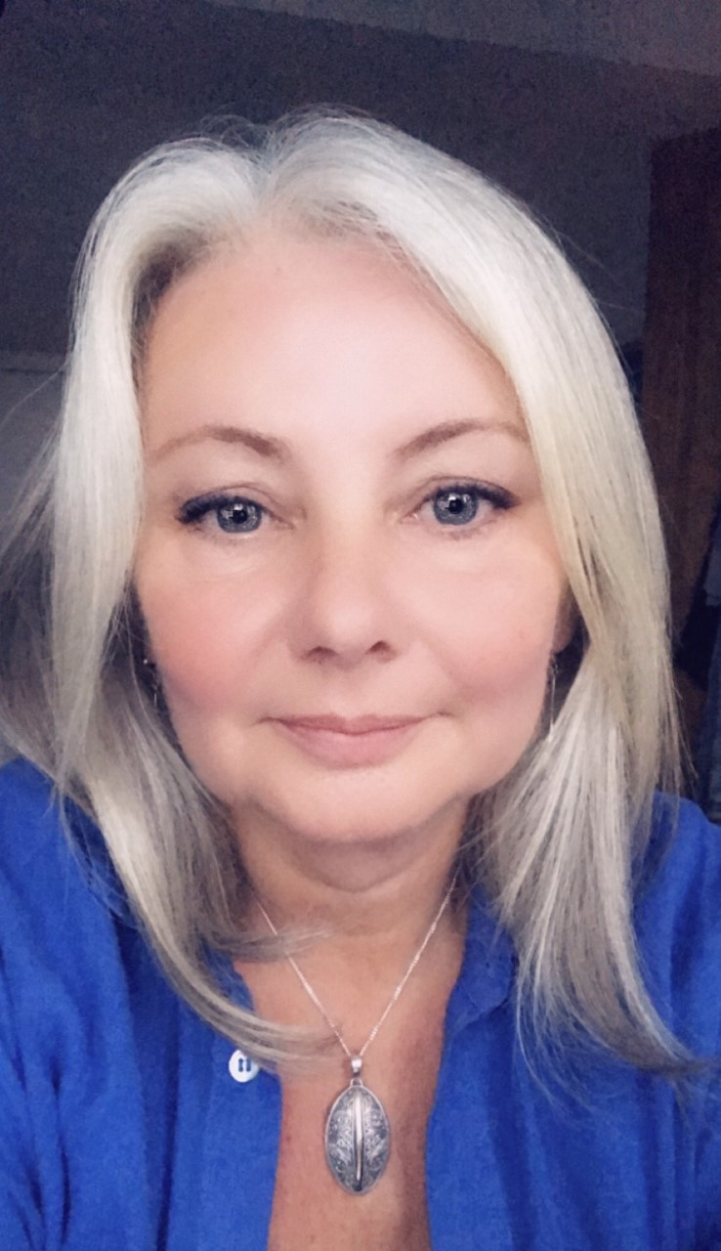
Meet your Teaching Assistant – Mrs Beesley
Facts about Mrs Beesley:
I love art and being creative
I love reading and sharing books
I enjoy looking after plants and gardening
I have three daughters and a Westie called Charlie who loves going for walks in the park

Slide 4
Meet your Teaching Assistant – Mrs Buchanan
Facts about Mrs Buchanan:
I love nature and the countryside
I love walking and going on bike rides
I enjoy playing golf
I have a cat called Tabitha who is 21!

Slide 5
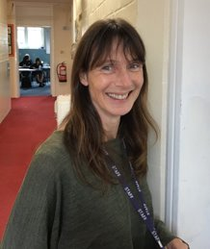
Meet your Teaching Assistant – Mrs Bean
Facts about Mrs Bean:
I love going camping
I like travelling to different countries
I love reading
I enjoy playing netball
I love spending time with my family

Slide 6
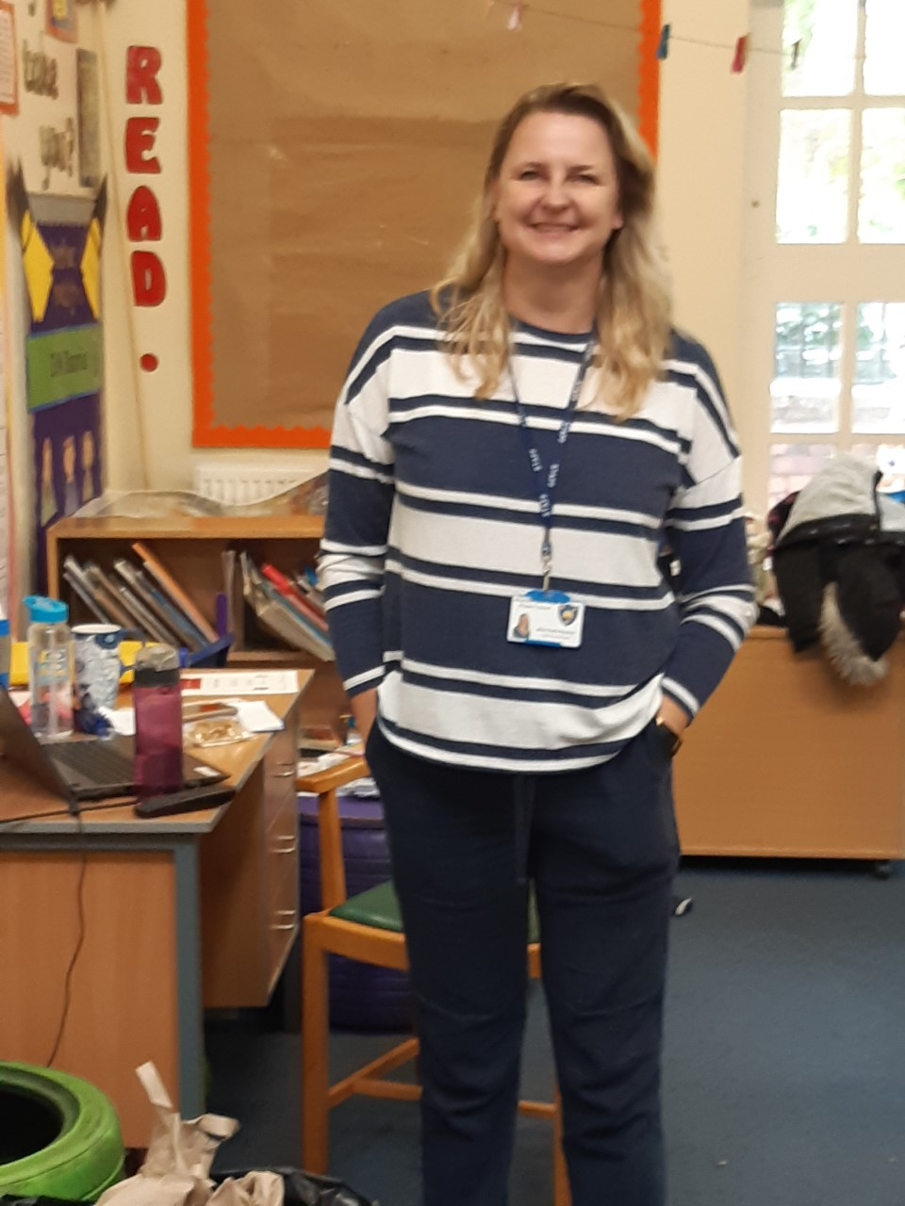
Meet your teaching assistant (and teacher on Thursday afternoons)- Miss Rushton
Facts about Miss Rushton:
I love to sing and listen to live music
My amazing 4 children keep me busy and happy
I enjoy reading stories and funny poems
I adore my 3 spoilt cats Smudge, Mittens and Bobby Bear
My favourite thing to do is sit in my garden on a sunny day

Slide 7
Learning is FUN in Year 1
We are very excited to explore some AMAZING Year 1 topics with you. We have been busy planning some fairy tale challenges, superhero adventures, dinosaur days, exploring the Earth and learning all about London.
Each of our topics are going to be based around a key text, which we will explore in all lessons. To start with we will be learning through play, just like in Reception. I can’t wait to set up the classroom with lots of areas and challenges for you to complete.
We are also going to spend LOTS of time thinking about how we can build relationships, manage our feelings and behaviour, enjoy and achieve and re-engage with physical health and wellbeing routines as well as learn new routines.

Slide 8
What will our classroom look like?
I am very excited to tell you that our Year 1 classroom will look very different in September! We are lucky enough to be moving into the Year 2 classroom and we will have our own outdoor area. We are currently setting up the new Year 1 classroom and outdoor area…
You will use the same pegs and toilets you have used in Reception.
On the next slide there are some pictures to show you what the classroom and outdoor area look like now. It will look different to this in September.

Slide 9
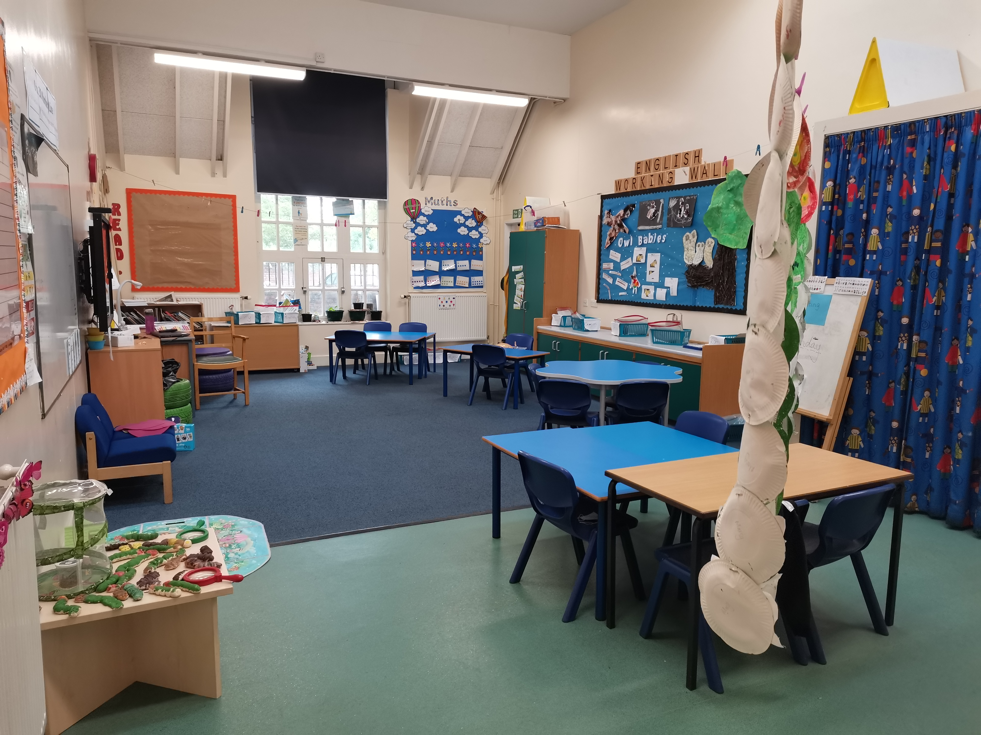
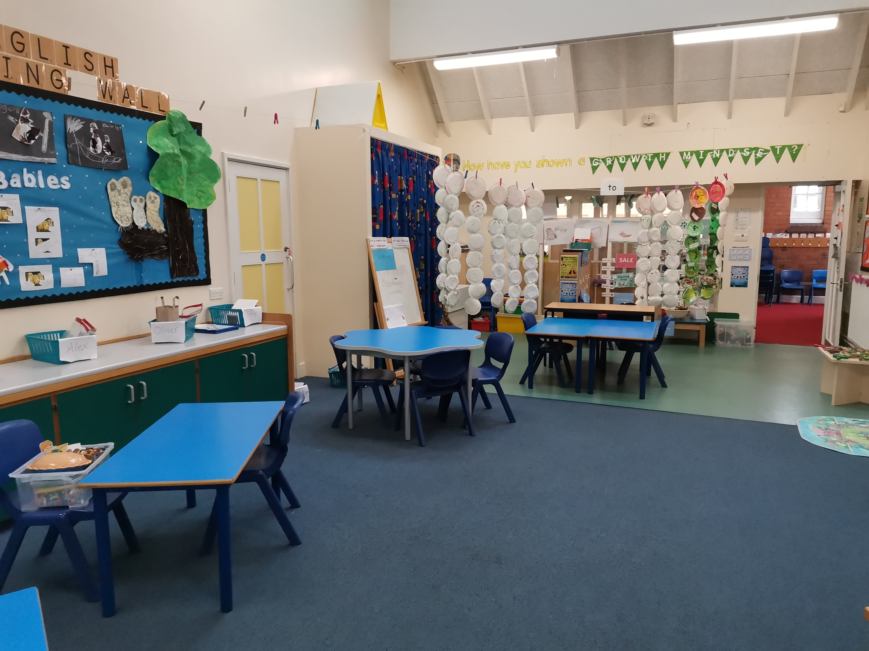
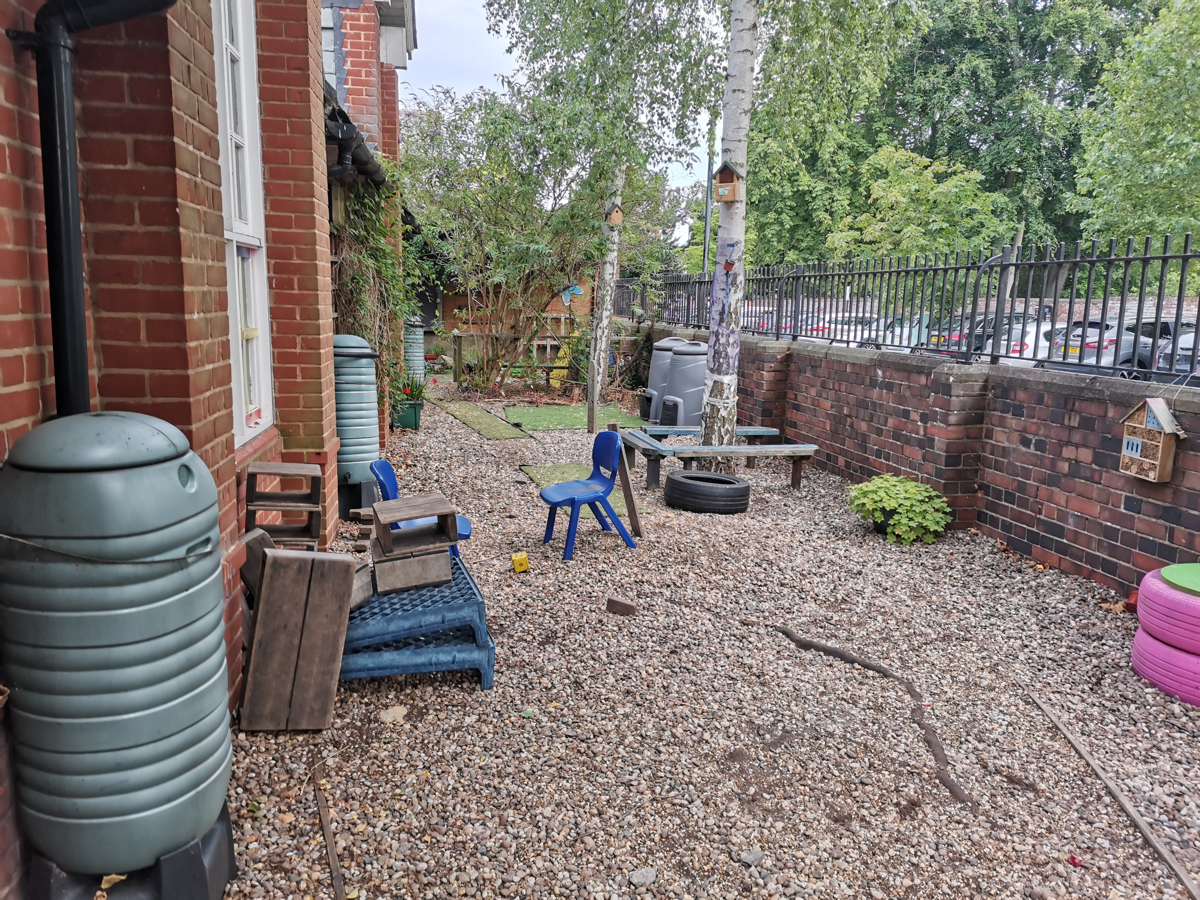

Slide 10
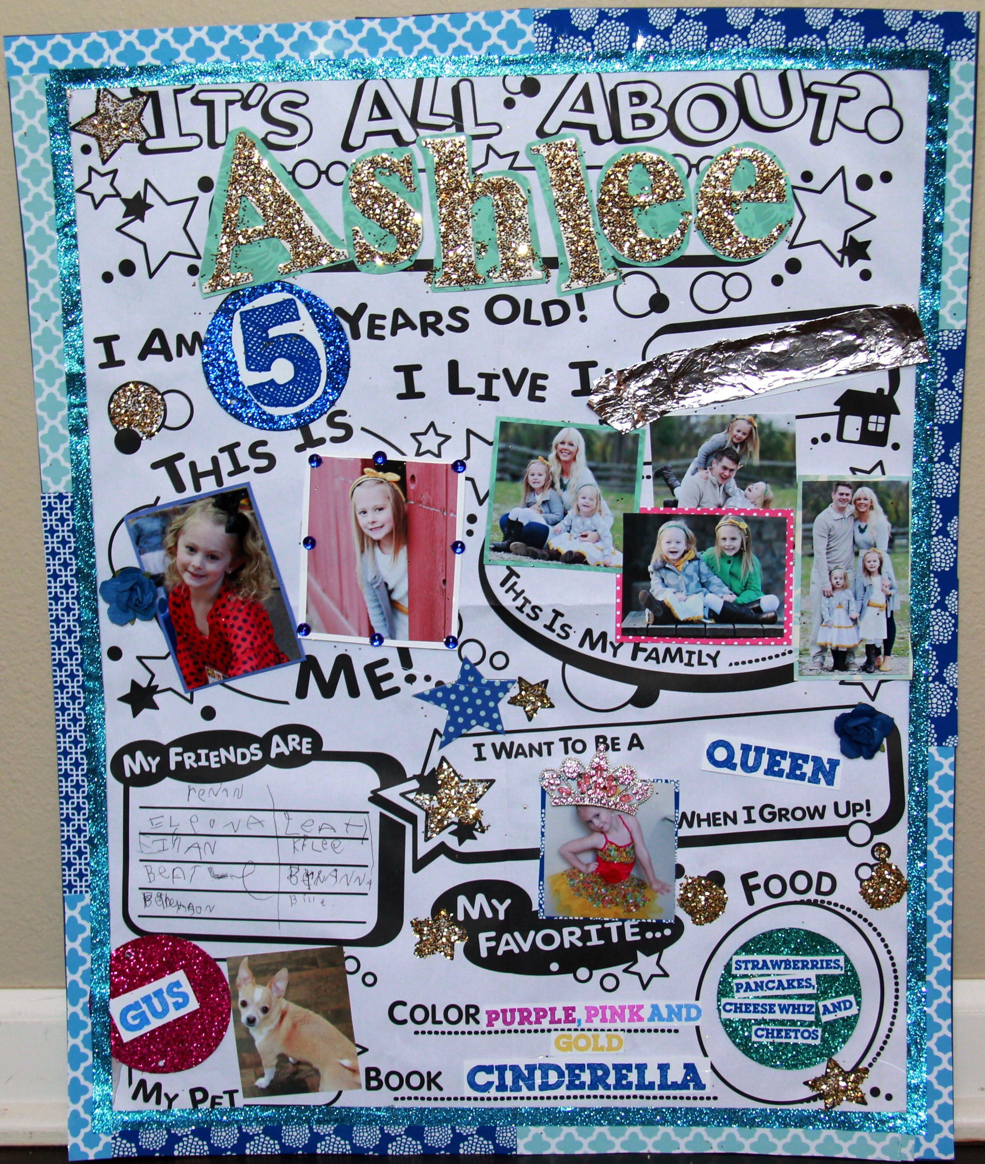
Summer project
To help us to get to know you a little better, we would like you to do a mini project over the Summer.
Please create a poster telling us about yourself. e.g who is in your family, who your friends are, what your hobbies are, your favourite food etc.
Be as creative and colourful as you like. You can use pictures, words, photos or drawings.

Slide 11
Questions or Queries
We are happy to take any questions or queries you may have.
If you see us in school please do not hesitate to wave and say hello.
Parents can email our admin2042@welearn365.com address if they have any questions.

