Slide 1
Welcome to Year 2
Miss Postlethwaite, Mrs Beesley & Mrs Buchanan

Slide 2
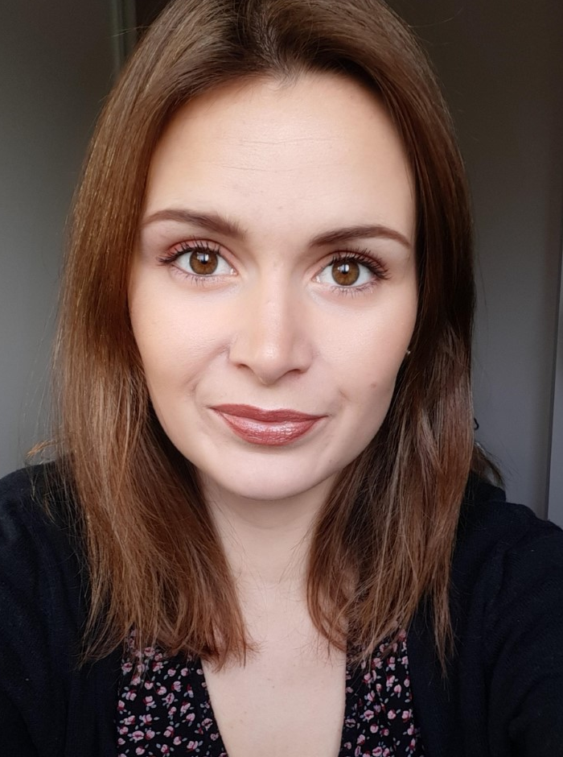
Meet your teacher - Miss Postlethwaite
Welcome to Year 2!
My name is Miss Postlethwaite and I will be your teacher next year.

Slide 3
A typical day in Year 2…
A typical day in Year 2 is very busy.
As soon as the children arrive at school they will put their belongings away and sit at their tables to quietly complete the morning activity during registration.
They then move straight into the morning sessions which consist of the core subjects English and Mathematics.
After lunch they will cover Topic based learning.
Throughout the day they will have a daily handwriting practice, spellings, whole class/ guided reading sessions, fluent in five and independent reading opportunities.

Slide 4
Assessment…
Assessment in KS1 is carried out daily with live marking happening during the lesson and as the children are working. This ensures that children have time to respond to the feedback, make changes and any misconceptions can be addressed immediately.
Children will take part in assessments in reading, writing and mathematics across the year to show progress and inform us of their next steps or any gaps in learning.
This year the children will be doing the Phonics screening test that normally takes place in Year 1 in the Autumn term. Normally the pass mark for this is 32 out of 40 but could be subject to change.
At the end of KS1 children will take the Statutory Assessment (SATS). However, this does not make up the whole picture. Teacher assessments are used to make the final judgement on whether children have met the Expected Standard for the end of KS1.

Slide 5
English, Maths and the other areas.
English – is based on a whole class text that is normally linked to that terms topic. Whole class reading also takes place daily to help children be immersed in a text. This means by the end of the half term they will have read and understood a novel.
Maths Mastery –is about deepening children’s understanding, use and manipulation of all things maths.
Fluent in five – takes place daily to help develop speed and accuracy with arithmetic skills.
We will also teach Geography, History, Science, French, ICT, RE, PSHE,
Music and Art/ Design. Learning in these subjects is where possible linked to each terms topics.
This year our term topics will be… If I were an insect, Making a mess, All around me, Turrets, towers and tunnels and Beside the Sea.

Slide 6
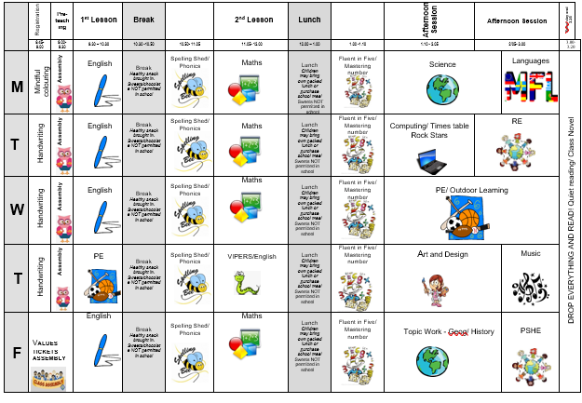

Slide 7
Home Learning…
Homework will be expected in on eschools weekly.
English and Maths homework will alternate each week.
Children will pick from the homework grid they are given each term which activity that they want to complete that week.
Children will also be given a spelling list to practice at home with a new pattern each week.
Children will have opportunities to read in school time throughout the week, but we strongly encourage home reading too. We ask that you use the reading record to record this.

Slide 8
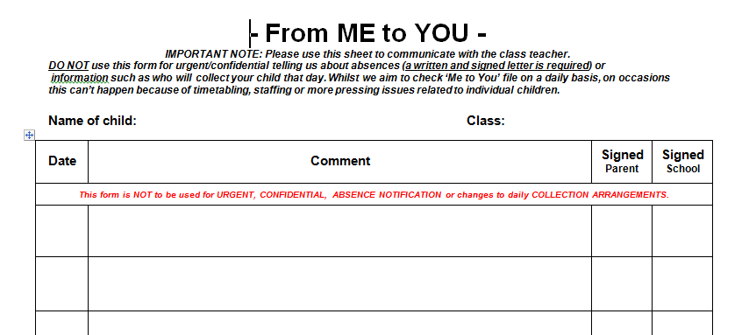
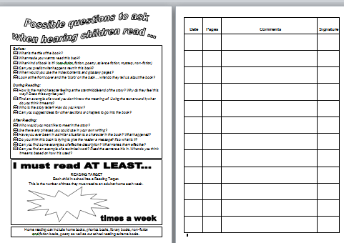
Communication…
Timetable
Home learning sheet
From me to you sheet
Reading diary
eSchools

Slide 9
Communication…
We are always here to support and listen whatever it may be. You can come talk to us on the door at the beginning or end of the day (being mindful of adults releasing children). We try our best to pass on all messages at home time.
If you have any minor queries, such as lost water bottles, you can contact use via eSchools or use the Me to You sheets. We will also use these and the reading diaries to send messages.
Important issues can be spoken about in person and appointments with teachers can either be done directly through teachers or via the school office.
Accident forms will be given out at the end of the day and any serious injuries will be either a phone call/face to face chat. Minor injuries such as cuts and grazes will be communicated via forms there may be instances where …
Please check the website for copies of home learning sheets and homework tasks.

Slide 10
Expectations…
Behaviour – high expectations, in class and in playground, in school on trips and when visitors are in and in after school clubs.
House points/ class dojo.
School uniform/PE kit/Lost Property – LABEL!
Presentation, in school and when completing homework.
Encourage independence – children to inform when they need a book changed, need to hand in a letter, bring sheets and uniform home, hand homework in.
Named water bottle needs to be in school every day.

Slide 11
Celebrating Success…
Well-being Warrior in celebration assembly
Stickers, Dojo points, House Points and Values Tickets
Topic Sharing Events
Looking at the website and Twitter

Slide 12
AOB…
Saying Goodbye at the door
Remind children at home they have a peg and box in which to store their items, encourage that independence
Come to school in Outdoor learning clothes on Wednesday and PE kit on Thursdays.
Following us on Twitter
RESPECT – the one school rule
Incidences between children at school

